Slide 1
MDP 32 – MEMS Feedback Controller
Team Members:
Adam Hess
Andrew Steinmann
Wesley Chiu

Slide 2
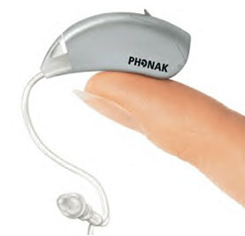
Problem Overview
Problems of current hearing-aids
Poor performance in noisy environments
Constant electronic static noise

Slide 3
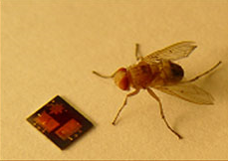
MEMS Microphone
Advantages:
Capable of directional hearing
Drastically reduced self noise to as low as 35dBA
Issues:
Introduces a resonant peak in the frequency response
Distorts the sound output
Measured diaphragm deflection shape
(vibration level is exaggerated)
“Response of a MEMS directional microphone diaphragm with active Q control” 159th Meeting of the Acoustical Society of America, Baltimore Maryland, 22 April 2010 – Dr. Quang Su

Slide 4
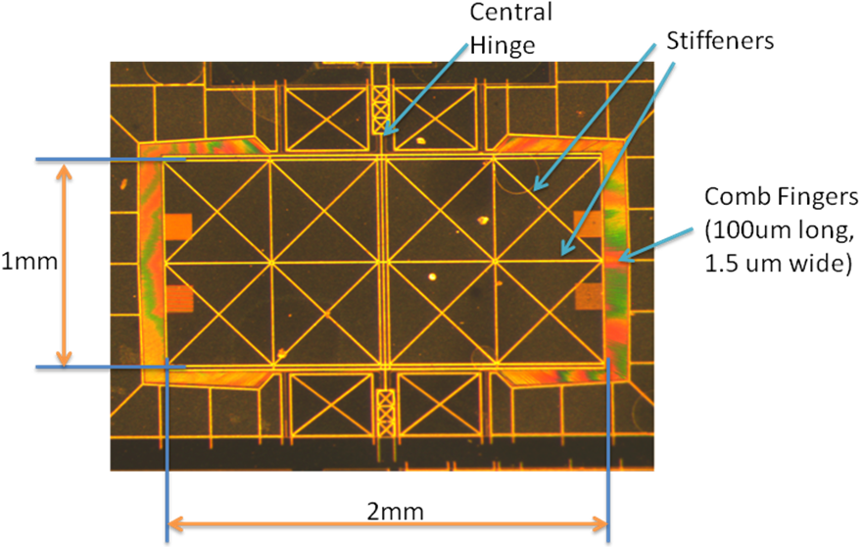
MEMS Microphone
“Response of a MEMS directional microphone diaphragm with active Q control” 159th Meeting of the Acoustical Society of America, Baltimore Maryland, 22 April 2010 - Dr. Quang Su

Slide 5
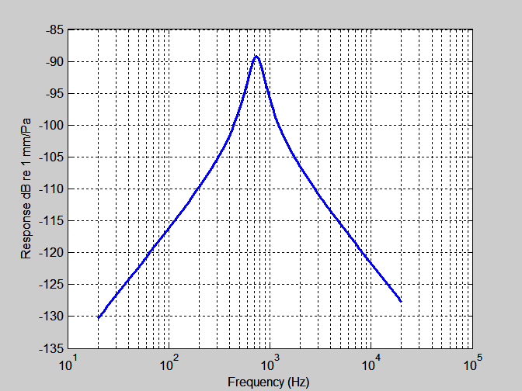
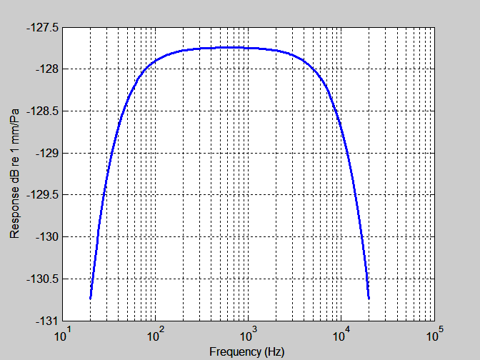
Project Goal
Reduce or remove the resonant peak

Slide 6
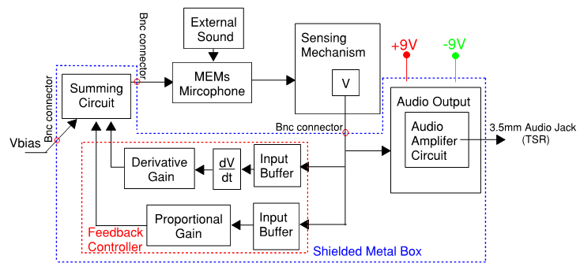
System Block Diagram

Slide 7
Requirements
Shall introduce analog feedback controller to make closed loop system pass frequencies of ~20Hz to ~20KHz with no gain
Closed loop system shall have a noise floor between 25 and 30dB
Shall be compatible with variations of the MEMs microphones
Device shall be portable
Device shall have an audio output with adjustable volume

Slide 8
Review: Last Semester
Designed a state variable feedback controller that required both a proportional and derivative signal from the laser-vibrometer
Developed noise models of system
Extensive research on parameter variation of feedback controller
Tested conceptual use of PD Controller

Slide 9
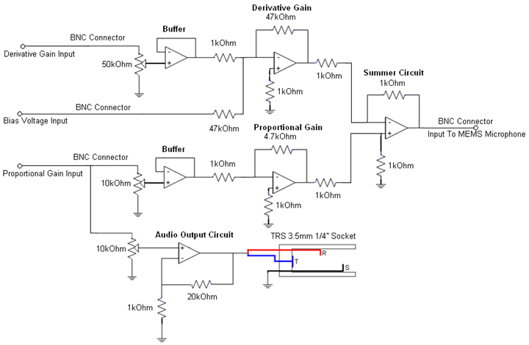
Last Semester: Final Project

Slide 10
Microphone Differential Equation
Must select operating point to linearize equation
Θ - diaphragm rotation
I – Mass moment of inertia
k_{t} – Torsional stiffness
c_{t} – Torsional dashpot
M – Moment due to sound field
V – Voltage
Θ

Slide 11
Linearization of Differential Equation
If V_{f} << V_{b}
[1] R. N. Miles and Q. T. Su, “Differential MEMS Microphone with Active Q-Control”, ME Dept. Binghamton University, October 2009

Slide 12
Controller Design : S-Domain
Determine Desired Closed Loop
I – Mass moment of inertia
k_{t} – Torsional stiffness
c_{t} – Torsional dashpot
Alpha – low cutoff frequency
Beta – high cutoff frequency
I_{A} - area moment of inertia
c_{p} – speed of sound

Slide 13
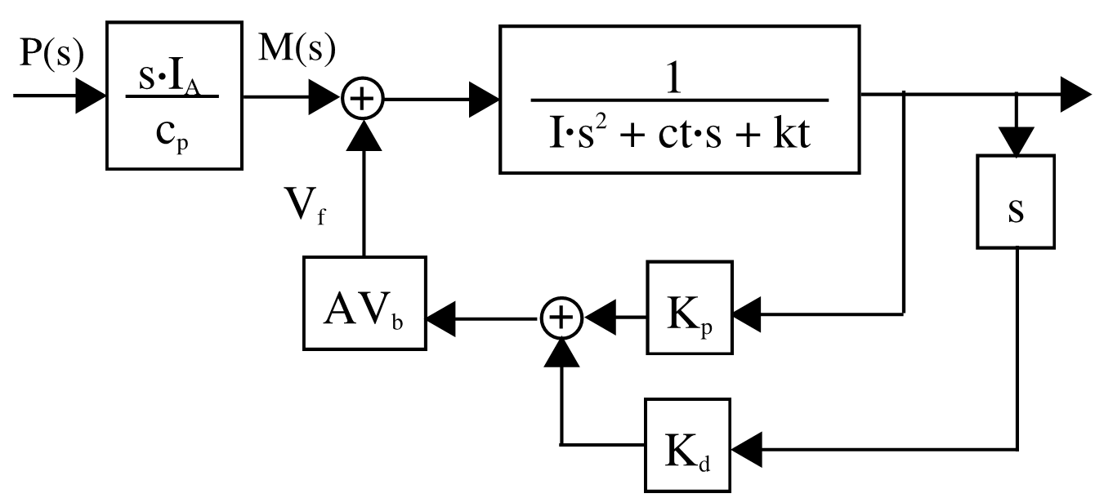
Controller Design
Linear Model – Assumes V_{b}>>V_{f}
Where

Slide 14
PD controller parameters

Slide 15
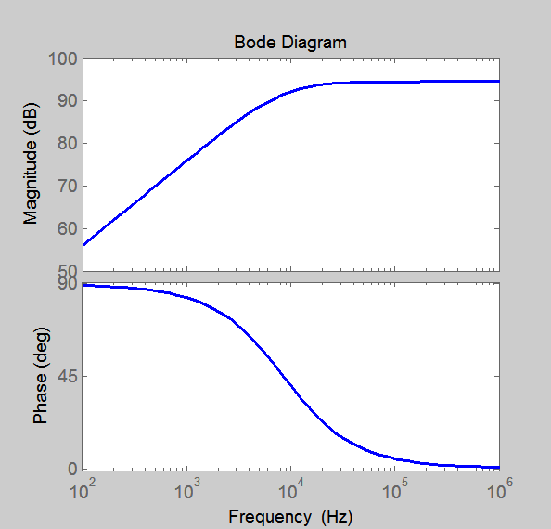
High Pass Filter
Operates as differentiator over frequency range of interest
Does not amplify high frequency noise

Slide 16
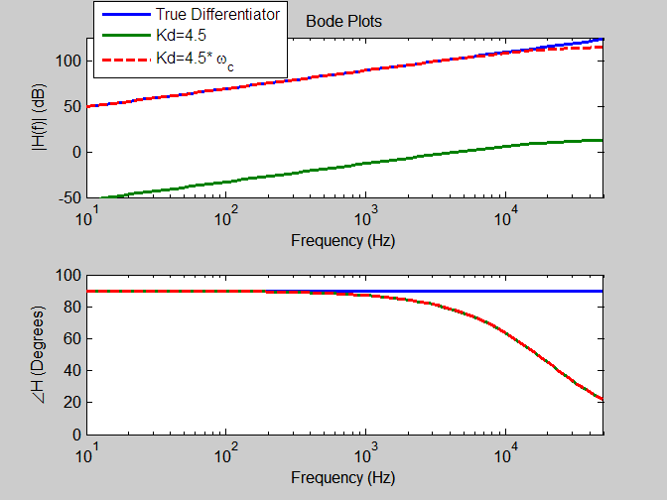
Implementation Problems
Gains
High pass filter gain

Slide 17
Gain/Bandwidth Compromise
A higher cutoff frequency requires a higher gain to provide the same control effect
The effectiveness of the feedback is constrained by the high pass filter gain
‘Perfect’ closed loop system requires unobtainable gains
Hearing aid application
Bandwidth requirement lowered

Slide 18
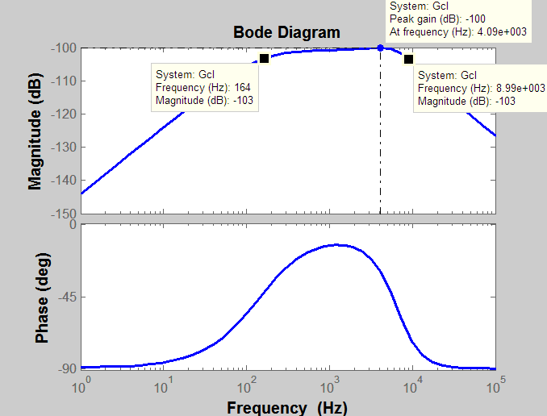
Closed Loop System Response
Kd = 60 Kp = -4.7 w_{c}=2*pi*8500 rad/s

Slide 19
Sound Simulation: Female Voice
Original Sound
Sound through simulated microphone
Closed Loop
Original Sound Provided by Prof. Quang Su

Slide 20
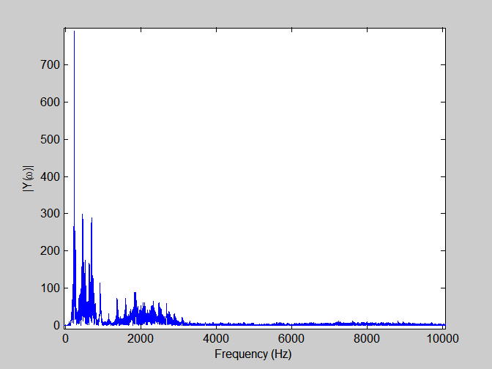
Fourier Transform: Orignal Signal

Slide 21
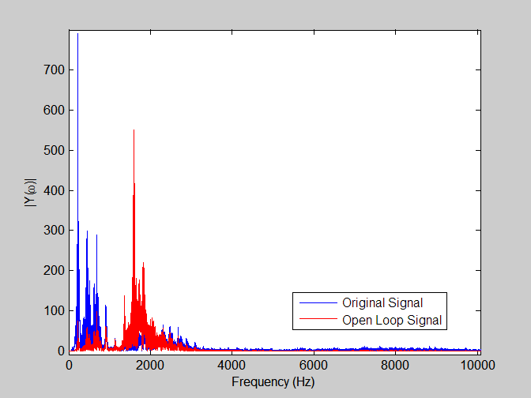
Fourier Transform: Open Loop

Slide 22
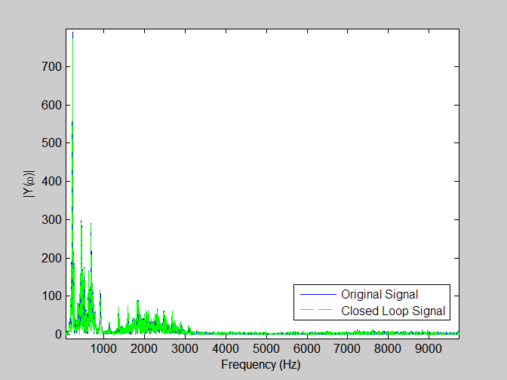
Fourier Transform: Closed Loop

Slide 23
Sound Simulation: Male Voice
Original Sound
Sound through simulated microphone
Closed Loop
Original Sound Provided by Prof. Quang Su

Slide 24
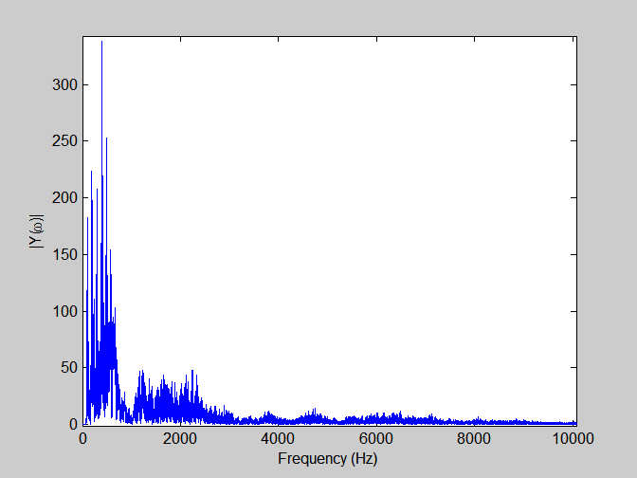
Fourier Transform of Original Signal

Slide 25
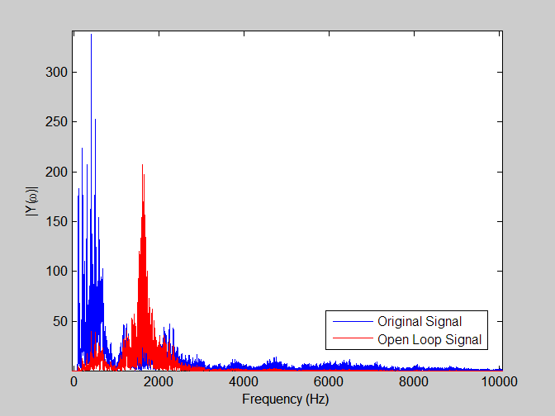
Fourier Transform of Microphone Signal

Slide 26
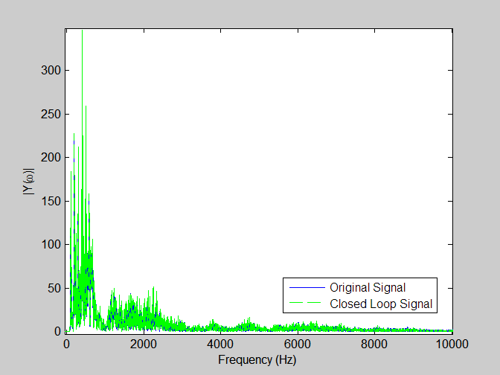
Fourier Transform of Closed Loop System

Slide 27
High Pass Filter Circuit

Slide 28
Audio Output Circuit

Slide 29
Summer Circuit

Slide 30
Final Circuit

Slide 31
Budget
Item # | Item Name | P/N (if applicable) | Cost / unit | Qanity | Total Cost
1 | 9v battery |  | $3.00 | 2 | $6.00
2 | AD797 (Free Samples) |  | $8.76 | 15 | $0.00
3 | Resistors (330 pcs) |  | $8.00 | 1 | $8.00
4 | Capacitors (15 pcs) |  | $3.00 | 1 | $3.00
5 | TL084 Op Amp | 296-1784-5-ND | $0.88 | 5 | $4.40
6 | Oscillascope (Owned by school) |  |  |  | $0.00
7 | Power Supply (Owned by school) |  |  |  | $0.00
8 | Function generator (Owned by school) |  |  |  | $0.00
9 | Matlab (School License) |  |  |  | $0.00
10 | Audio Jack 3.5mm 1/4'' |  | $3.00 | 1 | $3.00
11 | Chasis Material |  | $30.00 | 1 | $0.00
 |  |  |  | Total | $24.40
No PCB, LOW COSTS

Slide 32
Testing Schedule: Unit
 | Week of |  | 22-Feb | 1-Mar | 8-Mar
Task Name | Responsible Party
Summer Circuit test | Entire Team | Exp | 50% | 100%
 |  | Act | 50% | 100%
Differenitator test | Entire Team | Exp |  | 50% | 100%
 |  | Act |  | 35% | 100%
Audio Output Test | Entire Team | Exp |  | 50% | 100%
 |  | Act |  | 50% | 100%

Slide 33
Testing: High Pass Filter

Slide 34
Summer Circuit
Applied sinusoid
Applied DC bias
Varied amplitudes of each independently
Observe effects
Passed tests

Slide 35
Audio
Applied various frequencies of sinusoids
Varied amplitude knob
Listened to effects on headphones
Passed tests

Slide 36
System Test
 | Week of |  | 15-Mar | 22-Mar
Full Controller Test | Entire Team | Exp | 50% | 100%
 |  | Act | 50% | 100%
Adjustable Gains Test | Entire Team | Exp | 50% | 100%
 |  | Act | 50% | 100%

Slide 37
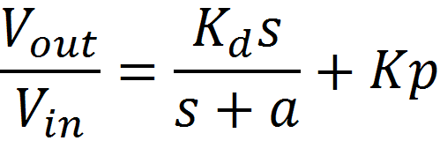
Testing: Full Controller

Slide 38
Customer Integration
 | Week of |  | 29-Mar | 5-Apr | 12-Apr | 19-Apr | 26-Apr
Closed Loop Transfer Function | Entire Team | Exp | 50% | 100%
 |  | Act | 20% | 30% | 30% | 75% | 100%
Closed Loop Stability Test | Entire Team | Exp | 50% | 100%
 |  | Act | 30% | 50% | 50% | 75% | 100%

Slide 39
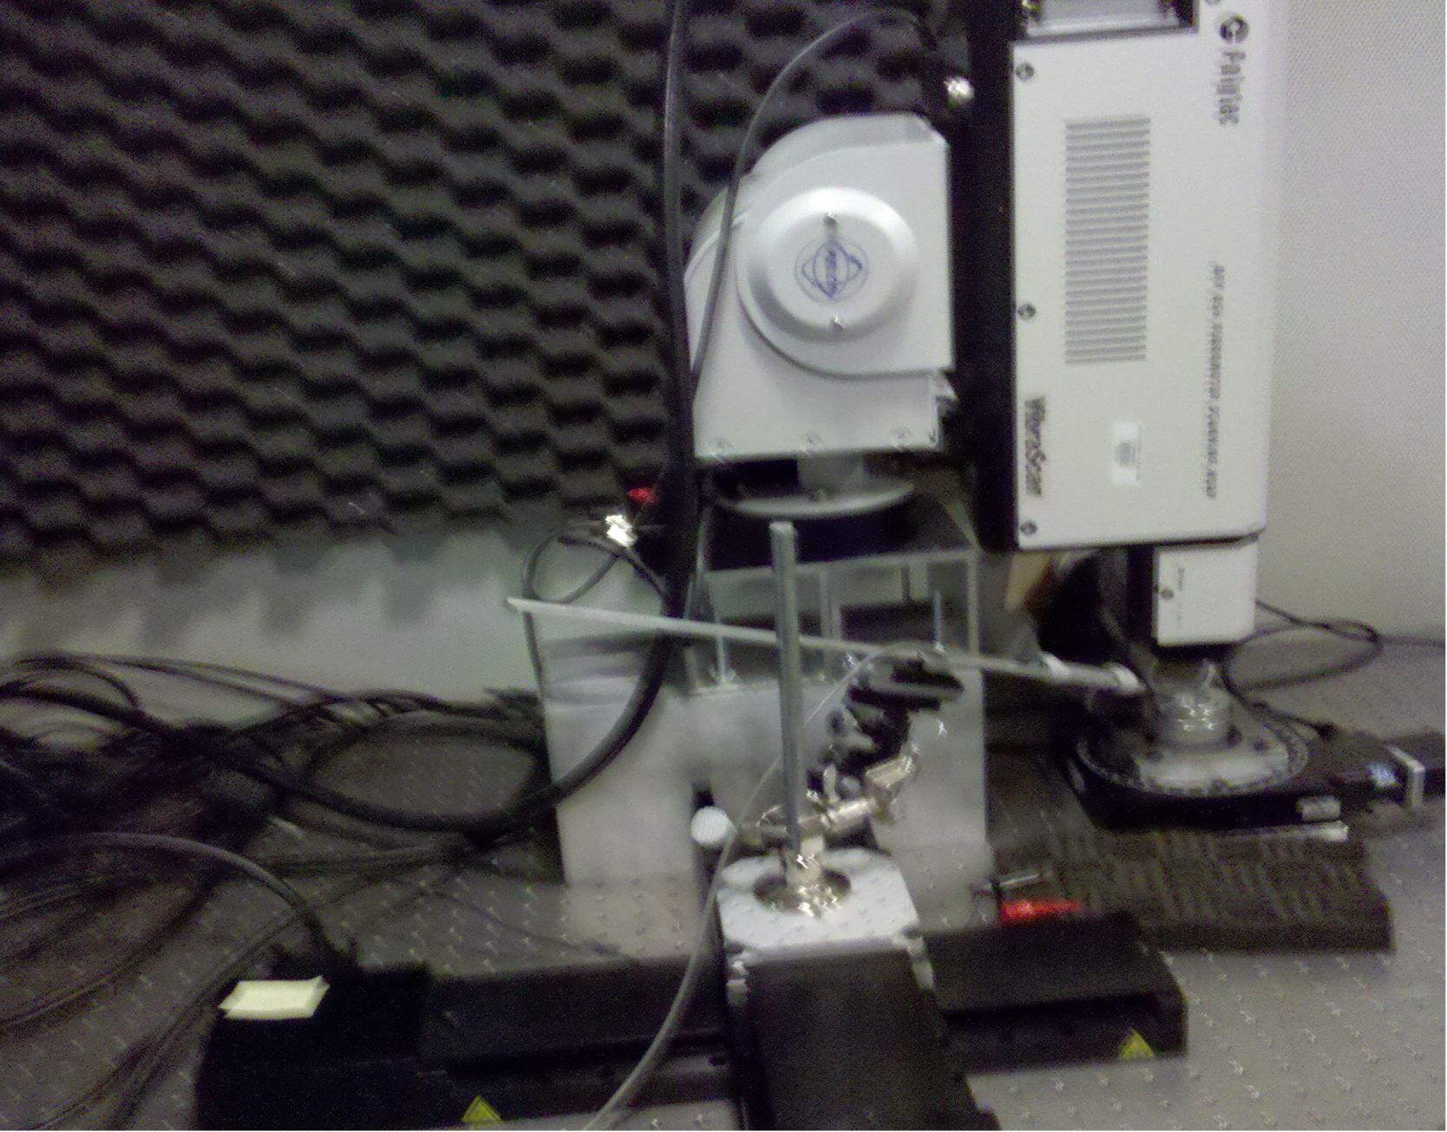
Test Setup: Laser Vibrometer

Slide 40
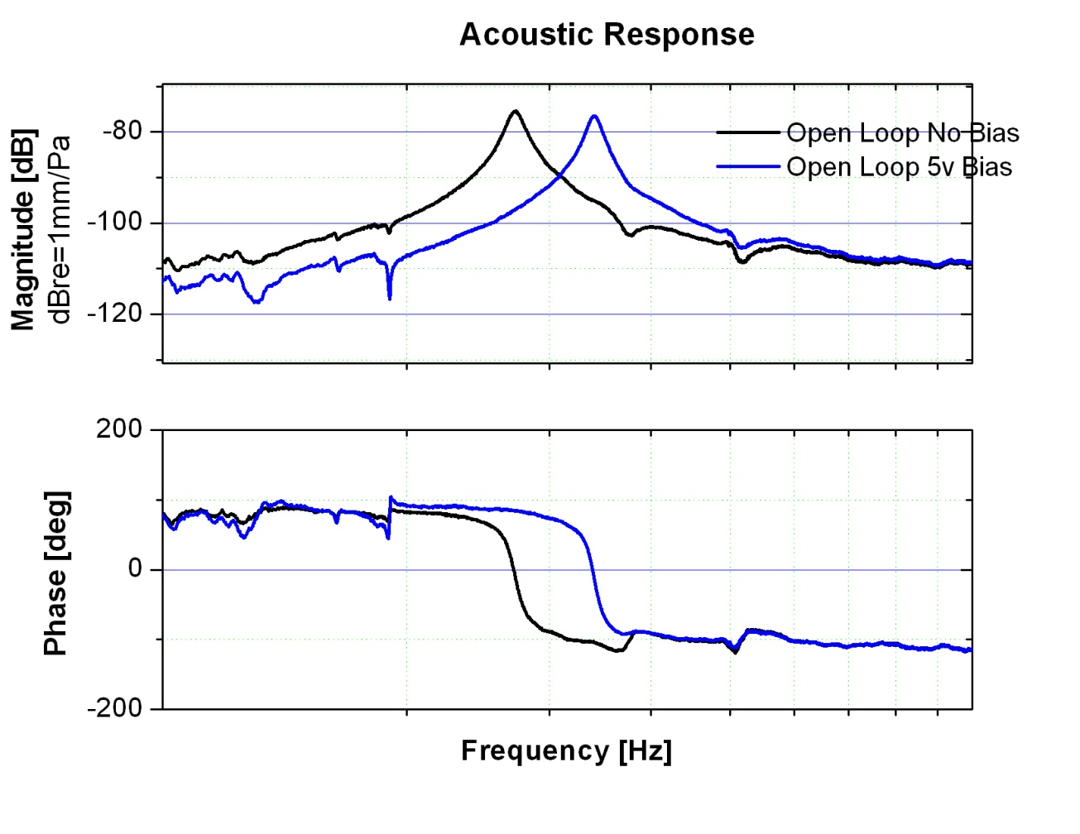
Testing: Open Loop System

Slide 41
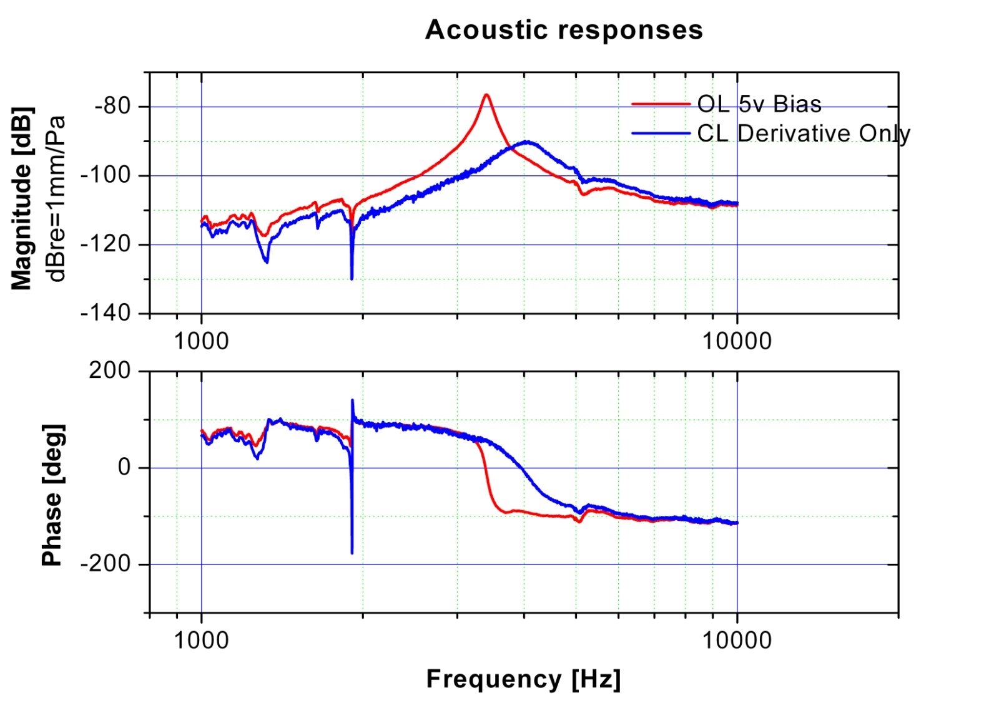
Closed Loop Derivative only

Slide 42
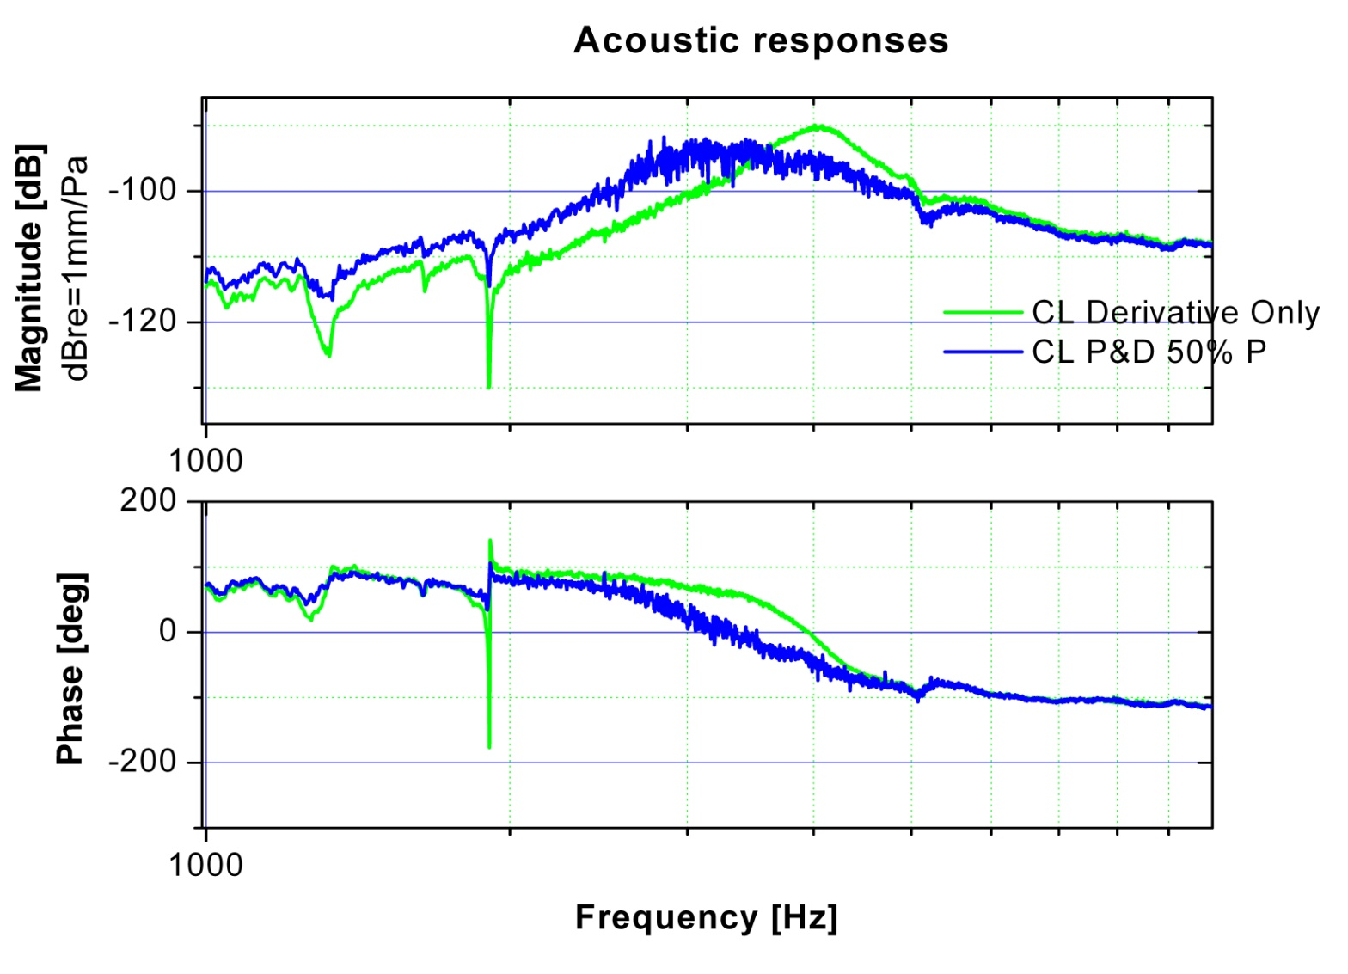
Closed Loop Derivative And Bias

Slide 43
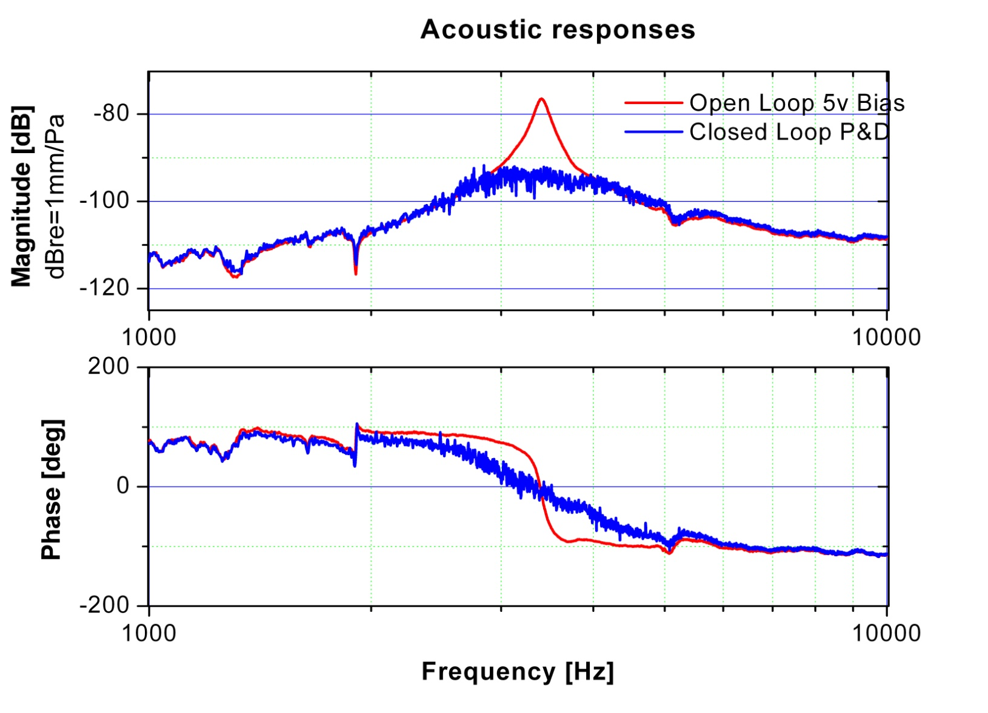
Full Closed Loop System

Slide 44
Testing Schedule: Canceled
 | Week of |  | 22-Mar | 29-Mar | 5-Apr
Task Name | Responsible Party
PCB Check | Entire Team | Exp | 50% | 100%
 |  | Act | 50% | X
85dB Clipping Test | Entire Team | Exp |  | 50% | 100%
 |  | Act |  | X | X
55dB Dynamic Range Test | Entire Team | Exp | 50% | 100% | 100%
 |  | Act | X | X | X
Noise Floor Test | Entire Team | Exp |  | 50% | 100%
 |  | Act |  | X | X

Slide 45
Conclusion
Controller Frequency Response was as predicted
Project goal to reduce resonant peak achieved
Gains required by the PD controller are unfeasible.
System requires more gain to lower the resonant peak and obtain greater bandwidth
Increasing gains increases the non linear effects

Slide 46
Acknowledgments
Professor Ronald Miles
Professor Eva Wu
Professor Quang Su

